Slide 1
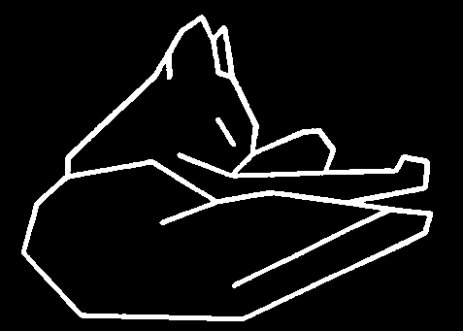
Introduction
Human and Computer Vision with Advanced Topics
Feature Extraction
Zhigang Zhu, City College of New York zzhu@ccny.cuny.edu
Notes:
This course is a basic introduction to parts of the field of computer vision. This version of the course covers topics in 'early' or 'low' level vision and parts of 'intermediate' level vision. It assumes no background in computer vision, a minimal background in Artificial Intelligence and only basic concepts in calculus, linear algebra, and probability theory.

Slide 2
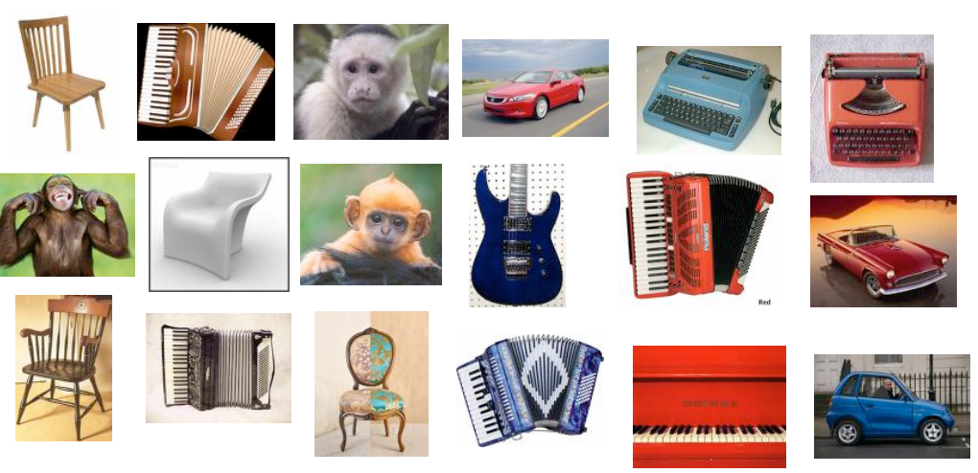
Human and Machine Vision: what features will be useful?
Notes:
It depends on the task. Assume that we want to classify these images.

Slide 3
Bag-of-pixels
We could create a bag-of-pixels vector for an image
characterize colors by clustering RGB values;
count the number of pixels in an image in each RGB bin
But colors do not capture an image in the same way that words capture a document.

Slide 4
Outline
Convolution: an Introduction
Image Enhancement: Noise Reduction (1)
Convolution: a Revisit
Image Enhancement: Noise Reduction (2)
Edge Detection
An Example: SIFT

Slide 5
Outline
Convolution: an Introduction
Image Enhancement: Noise Reduction (1)
Convolution: a Revisit
Image Enhancement: Noise Reduction (2)
Edge Detection
An Example: SIFT

Slide 6
Convolution: an introduction
Filtering: replace each pixel by the weighted combination of that pixel and neighbor pixels; weights are determined by a filter
This function is referred to as convolution
A linear filter produces an identical image:
A blurring filter produces a blurred image:
0 | 0 | 0
0 | 1 | 0
0 | 0 | 0
1 | 1 | 1
1 | 1 | 1
1 | 1 | 1
Notes:
convolution is very useful for signal processing in general. There is a lot of complex mathematical theory available for convolutions.
You can use a simple matrix as an image convolution kernel/filter to process an image or detect certain features.

Slide 7
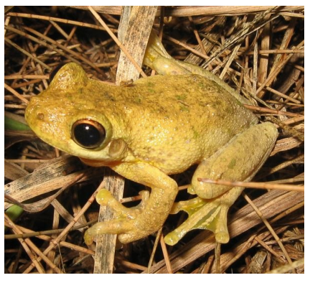
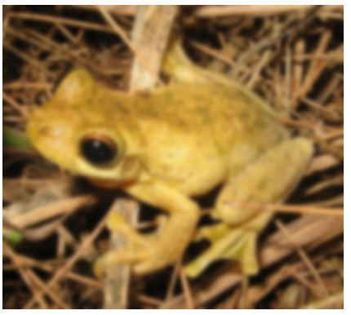
Image filters
0 | 0 | 0
0 | 1 | 0
0 | 0 | 0
1 | 1 | 1
1 | 1 | 1
1 | 1 | 1
https://softwarebydefault.com

Slide 8
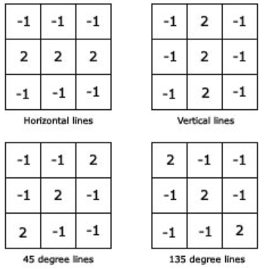
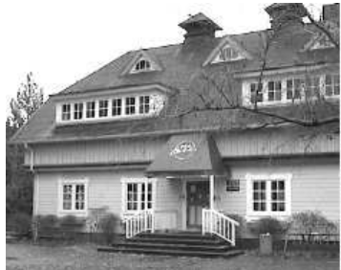
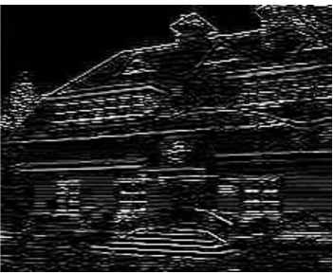
Detecting features: edge
We can use specific filters to identify features in an image
Consider: edges, corners, blobs, patterns (e.g., polka-dots, stripes)
Line detection with 4 filters
https://aishack.in/tutorials/image-convolution-examples/

Slide 9
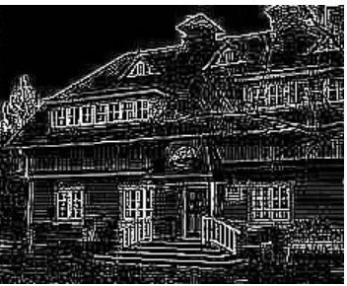
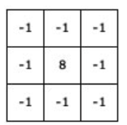
Detecting features: edge
We can use specific filters to identify features in an image
Consider: edges, corners, blobs, patterns (e.g., polka-dots, stripes)
Merge the 4 filters
Line detection with the combined filter
https://aishack.in/tutorials/image-convolution-examples/

Slide 10
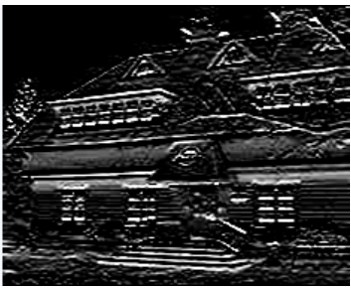
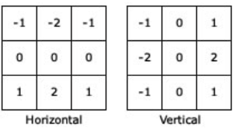
Detecting features: edge
We can use specific filters to identify features in an image
Consider: edges, corners, blobs, patterns (e.g., polka-dots, stripes)
The Sobel filter
Edge detection with the Sobel filter
https://aishack.in/tutorials/image-convolution-examples/
Notes:
The previous operators are very prone to noise. The Sobel edge operators have a smoothing effect, so they're less affected to noise. Again, there's a horizontal component and a vertical component. It works by calculating the gradient of image intensity at each pixel within the image. It finds the direction of the largest increase from light to dark and the rate of change in that direction.

Slide 11
Outline
Convolution: an Introduction
Image Enhancement: Noise Reduction (1)
Convolution: a Revisit
Image Enhancement: Noise Reduction (2)
Edge Detection
An Example: SIFT

Slide 12
Image Enhancement
Goal: improve the ‘visual quality’ of the image
for human viewing
for subsequent processing
Two typical methods
spatial domain techniques....
operate directly on image pixels
frequency domain techniques....
operate on the Fourier transform of the image
No general theory of ‘visual quality’
General assumption: if it looks better, it is better
Often not a good assumption

Slide 13
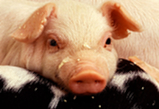

Spatial Domain Methods
T(I(x,y))
neighborhood N
I(x,y)
I’(x,y)
Transformation T
point - pixel to pixel
area - local area to pixel
global - entire image to pixel
Neighborhoods
typically rectangular
typically an odd size: 3x3, 5x5, etc
centered on pixel I(x,y)
Many IP algorithms rely on this basic notion
I’(x,y) = T(I(x,y))
O=T(I)

Slide 14
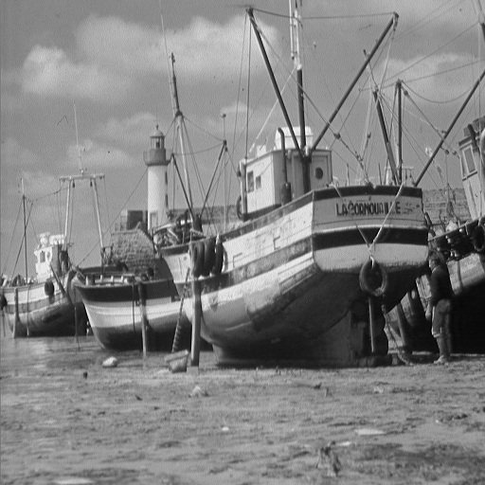
Noise Reduction
What is noise?
How is noise reduction performed?
Noise reduction from first principles
Neighbourhood operators
linear filters (low pass, high pass)
non-linear filters (median)
+
=
image
noise
‘grainy’ image

Slide 15
Noise
Image
Plot of image brightness.
Noise is additive.
Noise fluctuations are rapid
high frequency.
Noise
Image + Noise

Slide 16
Noise
Noise varies above and below uncorrupted image.
Image
Image
+
Noise

Slide 17
Noise Reduction - 1
How do we reduce noise?
Consider a uniform 1-d image and add noise.
Focus on a pixel neighbourhood.
Averaging the three values should result in a value closer to original uncorrupted data
Especially if gaussian mean is zero
A_{i-1} A_{i} A_{i+1}
C_{i}

Slide 18
Noise Reduction - 1
Averaging ‘smoothes’ the noise fluctuations.
Consider the next pixel A_{i+1}
Repeat for remainder of pixels.
A_{i-1} A_{i} A_{i+1} A_{i+2}
C_{i+1}

Slide 19
Neighborhood Operations
All pixels can be averaged by convolving 1-d image A with mask B to give enhanced image C.
Weights of B must equal one when added together.
Why?
C = A * B
B = [ B1 B2 B3 ]
C_{i} = A_{i-1} ×B₁ + A_{i} ×B₂ + A_{i+1} ×B₃
B = [1 1 1]
C_{i} =
1
3
A_{i-1} + A_{i} + A_{i+1}
3

Slide 20


2D Analog of 1D Convolution
Consider the problem of blurring a 2D image
Here’s the image and a blurred version:
How would we do this?
What’s the 2D analog of 1D convolution?

Slide 21
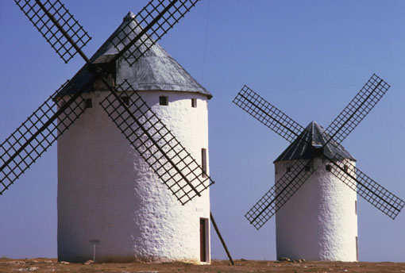

2D Blurring Kernel
C = A * B
B becomes
1 1 1
1 1 1
1 1 1
1
B =
9

Slide 22
Outline
Convolution: an Introduction
Image Enhancement: Noise Reduction (1)
Convolution: a Revisit
Image Enhancement: Noise Reduction (2)
Edge Detection
An Example: SIFT

Slide 23
Convolution
Extremely important concept in computer vision, image processing, signal processing, etc.
Lots of related mathematics (we won’t do)
General idea: reduce a filtering operation to the repeated application of a mask (or filter kernel) to the image
Kernel can be thought of as an NxN image
N is usually odd so kernel has a central pixel
In practice
(flip kernel)
Align kernel center pixel with an image pixel
Pointwise multiply each kernel pixel value with corresponding image pixel value and add results
Resulting sum is normalized by kernel weight
Result is the value of the pixel centered on the kernel

Slide 24
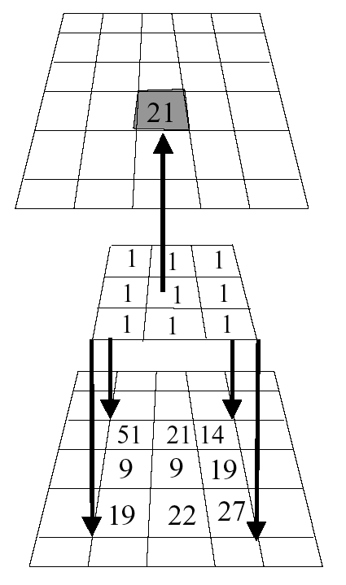
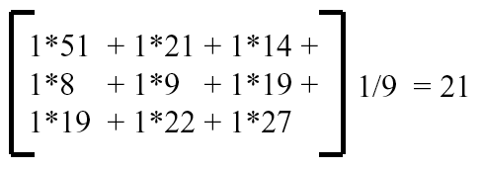
Example
Kernel is aligned with pixel in image, multiplicative sum is computed, normalized, and stored in result image.
Process is repeated across image.
What happens when kernel is near edge of input image?
Result
Image
Kernel
Image

Slide 25
Convolution Size
Image size = M₁ × N₁
Mask size = M₂ × N₂
N₁
Convolution size =
M₁- M₂ +1 × N₁-N₂+1
N₂
N₁-N₂+1
Typical Mask sizes
= 3×3, 5 ×5, 7×7,
9 ×9, 11×11
What is the convolved
image size for a 128
× 128 image and
7 × 7 mask?

Slide 26
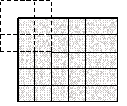
Border Problem
missing samples are zero
missing samples are gray
copying last lines
reflected indexing (mirror)
circular indexing (periodic)
truncation of the result

Slide 27
Convolution
= I M
*

Slide 28
Noise Reduction - 1
Image + Noise
Image + Noise - Blurred
Uncorrupted Image

Slide 29
Noise Reduction - 1
Technique relies on high frequency noise fluctuations being ‘blocked’ by filter. Hence, low-pass filter.
Fine detail in image may also be smoothed.
Balance between keeping image fine detail and reducing noise.

Slide 30
Noise Reduction - 1
Saturn image coarse detail
Boat image contains fine detail
Noise reduced but fine detail also smoothed

Slide 31


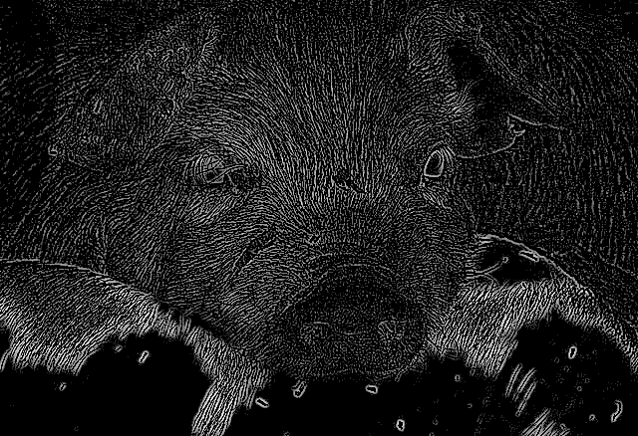
hmmmmm…..
Image
Blurred Image
-
=

Slide 32
Outline
Convolution: an Introduction
Image Enhancement: Noise Reduction (1)
Convolution: a Revisit
Image Enhancement: Noise Reduction (2)
Edge Detection
An Example: SIFT

Slide 33
Noise Reduction - 2: Median Filter
Nonlinear Filter
Compute median of points in neighborhood
Has a tendency to blur detail less than averaging
Works very well for ‘shot’ or ‘salt and pepper’ noise
Original
Low-pass
Median
Notes:
How does media filter work?
Get data from a window centered at the to-be-processed pixel
Sort the data (from min to max)
Put the median value in the filtered image

Slide 34
Noise Reduction - 2
Low-pass
Median
Low-pass: fine detail smoothed by averaging
Median: fine detail passed by filter

Slide 35
Summary
Summary
Conclusion
What is noise?
Gaussian distribution
Noise reduction
first principles
Neighbourhood
low-pass
median
Averaging pixels corrupted by noise cancels out the noise.
Low-pass can blur image.
Median may retain fine image detail that may be smoothed by averaging.

Slide 36
Outline
Convolution: an Introduction
Image Enhancement: Noise Reduction (1)
Convolution: a Revisit
Image Enhancement: Noise Reduction (2)
Edge Detection
An Example: SIFT

Slide 37
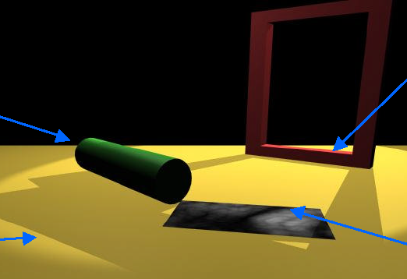
Discontinuities
B
A
C
D
A: Depth discontinuity: abrupt depth change in the world
B: Surface normal discontinuity: change in surface orientation
C: Illumination discontinuity: shadows, lighting changes
D: Reflectance discontinuity: surface properties, markings

Slide 38

Illusory Edges
Kanizsa Triangles
Illusory edges will not be detectable by the algorithms that we will discuss
No change in image irradiance - no image processing algorithm can directly address these situations
Computer vision can deal with these sorts of things by drawing on information external to the image (perceptual grouping techniques)

Slide 39
Another One

Slide 40
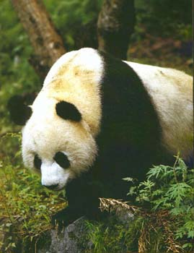
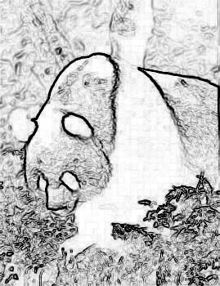
Goal
Devise computational algorithms for the extraction of significant edges from the image.
What is meant by significant is unclear.
Partly defined by the context in which the edge detector is being applied

Slide 41
Edgels
Define a local edge or edgel to be a rapid change in the image function over a small area
implies that edgels should be detectable over a local neighborhood
Edgels are NOT contours, boundaries, or lines
edgels may lend support to the existence of those structures
these structures are typically constructed from edgels
Edgels have properties
Orientation
Magnitude
Position

Slide 42
Locating Edgels
Rapid change in image => high local gradient => differentiation
f(x) = step edge
1st Derivative f ’(x)
maximum
2nd Derivative -f ’’(x)
zero crossing

Slide 43
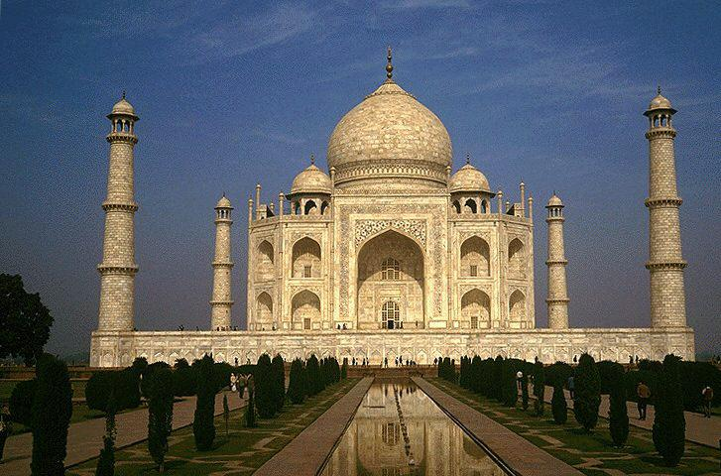
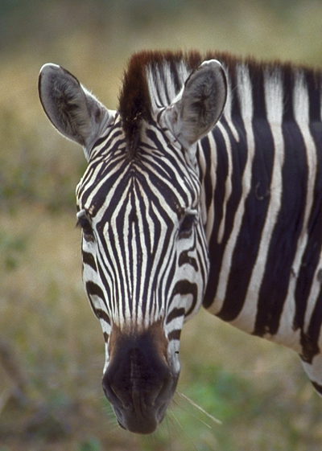
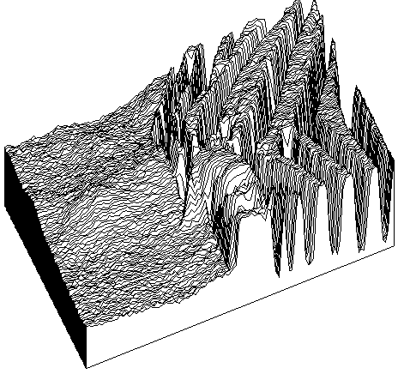
Reality

Slide 44



Properties of an Edge
Original
Orientation
Orientation
Position
Magnitude

Slide 45
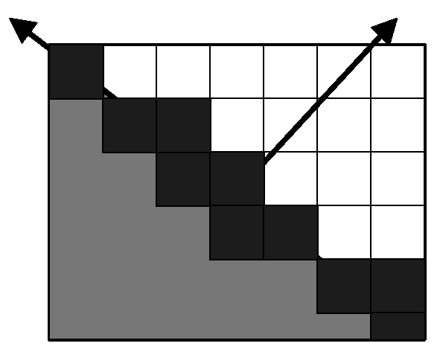
Quantitative Edge Descriptors
Edge Orientation
Edge Normal - unit vector in the direction of maximum intensity change (maximum intensity gradient)
Edge Direction - unit vector perpendicular to the edge normal
Edge Position or Center
image position at which edge is located (usually saved as binary image)
Edge Strength / Magnitude
related to local contrast or gradient - how rapid is the intensity variation across the edge along the edge normal.

Slide 46
Edge Degradation in Noise
Increasing noise
Ideal step edge
Step edge + noise

Slide 47
Edge Detection: Typical
Noise Smoothing
Suppress as much noise as possible while retaining ‘true’ edges
In the absence of other information, assume ‘white’ noise with a Gaussian distribution
Edge Enhancement
Design a filter that responds to edges; filter output high are edge pixels and low elsewhere
Edge Localization
Determine which edge pixels should be discarded as noise and which should be retained
thin wide edges to 1-pixel width (nonmaximum suppression)
establish minimum value to declare a local maximum from edge filter to be an edge (thresholding)

Slide 48
Real Image

Slide 49
Gradient Methods
F(x)
Edge= sharp variation
x
F’(x)
Large first derivative
x

Slide 50
Gradient of a Function
Assume f is a continuous function in (x,y). Then
are the rates of change of the function f in the x and y directions, respectively.
The vector (Δ_{x}, Δ_{y}) is called the gradient of f.
This vector has a magnitude:
and an orientation:
θ is the direction of the maximum change in f.
S is the size of that change.
Δ_{y}
θ = tan⁻¹ ( )
Δ_{x}

Slide 51
Geometric Interpretation
But
I(i,j) is not a continuous function.
Therefore
look for discrete approximations to the gradient.

Slide 52
Discrete Approximations
df(x)
f(x + Δx) - f(x)
f(x)
= lim
dx
Δx
Δx 0
df(x)
f(x) - f(x-1)
dx
≅
1
x-1
x
Convolve with -1 1

Slide 53
In Two Dimensions
Discrete image function I
Derivatives Differences
-1
Δ_{j}I =
-1 1
Δ_{i}I =
1

Slide 54
1x2 Example
1x2 Vertical
Combined
1x2 Horizontal

Slide 55
Smoothing and Edge Detection
Derivatives are 'noisy' operations
edges are a high spatial frequency phenomenon
edge detectors are sensitive to and accent noise
Averaging reduces noise
spatial averages can be computed using masks
Combine smoothing with edge detection.

Slide 56
Effect of Blurring
Original
Orig+1 Iter
Orig+2 Iter
Image
Edges
Thresholded
Edges

Slide 57
Combining the Two
Applying this mask is equivalent to taking the difference of averages on either side of the central pixel.

Slide 58
Many Different Kernels
Variables
Size of kernel
Pattern of weights
1x2 Operator (we’ve already seen this one
-1
Δ_{j}I =
-1 1
Δ_{i}I =
1

Slide 59
Roberts Cross Operator
Does not return any information about the orientation of the edge
S =
[ I(x, y) - I(x+1, y+1) ]² + [ I(x, y+1) - I(x+1, y) ]²
or
S =
| I(x, y) - I(x+1, y+1) | + | I(x, y+1) - I(x+1, y) |
1 0
0 -1
0 1
-1 0
+

Slide 60
Sobel Operator
-1 -2 -1
0 0 0
1 2 1
-1 0 1
-2 0 2
-1 0 1
S₁=
S₂ =
Edge Magnitude =
2
2
S₁ + S₂
S₁
Edge Direction =
tan⁻¹
S₂
Notes:
S1, S2 represent response to the kernels. Not the kernel themselves

Slide 61
Anatomy of the Sobel
1/4
+
Sobel kernel is separable!
1/4
Averaging done parallel to edge
Notes:
Explain how this is done.

Slide 62
Prewitt Operator
-1 -1 -1
0 0 0
1 1 1
-1 0 1
-1 0 1
-1 0 1
P₁=
P₂ =
Edge Magnitude =
2
2
P₁ + P₂
P₁
Edge Direction =
tan⁻¹
P₂
Notes:
P1, P2 represent response, not the kernels

Slide 63
Analysis of Edge Kernels
Analysis based on a step edge inclined at an angle θ (relative to y-axis) through center of window.
Robinson/Sobel: true edge contrast less than 1.6% different from that computed by the operator.
Error in edge direction
Robinson/Sobel: less than 1.5 degrees error
Prewitt: less than 7.5 degrees error
Summary
Typically, 3 x 3 gradient operators perform better than 2 x 2.
Prewitt2 and Sobel perform better than any of the other 3x3 gradient estimation operators.
In low signal to noise ratio situations, gradient estimation operators of size larger than 3 x 3 have improved performance.
In large masks, weighting by distance from the central pixel is beneficial.

Slide 64
Prewitt Example
Santa Fe Mission
Prewitt Horizontal and Vertical Edges Combined

Slide 65
Edge Thresholding
Global approach
Edge Histogram
64
128
T=128
T=64
See Haralick paper for thresholding based on statistical significance tests.

Slide 66
Second derivatives…

Slide 67
Edges from Second Derivatives
Digital gradient operators estimate the first derivative of the image function in two or more directions.
f(x) = step edge
1st Derivative f’(x)
maximum
GRADIENT
METHODS
2nd Derivative -f’’(x)
zero crossing

Slide 68
Second Derivatives
Second derivative = rate of change of first derivative.
Maxima of first derivative = zero crossings of second derivative.
For a discrete function, derivatives can be approximated by differencing.
Consider the one-dimensional case:
2
Δ f(i) = Δ f(i+1) - Δ f(i)
= f(i+1) - 2 f(i) + f(i-1)
Mask:

Slide 69
Laplacian Operator
Now consider a two-dimensional function f(x,y).
The second partials of f(x,y) are not isotropic.
Can be shown that the smallest possible isotropic second derivative operator is the Laplacian:
Two-dimensional discrete approximation is:

Slide 70
Example Laplacian Kernels
5X5
9X9
Note that these are not the optimal approximations to the Laplacian of the sizes shown.

Slide 71
Example Application
5x5 Laplacian Filter
9x9 Laplacian Filter

Slide 72

Detailed View of Results

Slide 73
Laplacian Enhancement
Blurred Original
3x3 Laplacian Enhanced

Slide 74
Noise
Second derivative, like first derivative, enhances noise
Combine second derivative operator with a smoothing operator.
Questions:
Nature of optimal smoothing filter.
How to detect intensity changes at a given scale.
How to combine information across multiple scales.
Smoothing operator should be
'tunable' in what it leaves behind
smooth and localized in image space.
One operator which satisfies these two constraints is the Gaussian:

Slide 75
2D Gaussian Distribution
The two-dimensional Gaussian distribution is defined by:
From this distribution, can generate smoothing masks whose width depends upon σ:

Slide 76
σ Defines Kernel ‘Width’
σ² = .25
σ² = 1.0
σ² = 4.0

Slide 77
Creating Gaussian Kernels
The mask weights are evaluated from the Gaussian distribution:
This can be rewritten as:
This can now be evaluated over a window of size nxn to obtain a kernel in which the (0,0) value is 1.
k is a scaling constant
i² + j²
W(i,j) = k * exp (- )
2 σ²
W(i,j)
i² + j²
= exp (- )
k
2 σ²

Slide 78
Example
Choose σ = 2. and n = 7, then:
2
j
-3
-2
-1
0
1
2
3
-3
-2
-1
i
0
1
2
3

Slide 79
Example
Plot of Weight Values
7x7 Gaussian Filter

Slide 80
Kernel Application
7x7 Gaussian Kernel
15x15 Gaussian Kernel

Slide 81
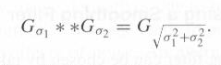
Why Gaussian for Smoothing
Gaussian is not the only choice, but it has a number of important properties
If we convolve a Gaussian with another Gaussian, the result is a Gaussian
This is called linear scale space
Efficiency: separable
Central limit theorem

Slide 82
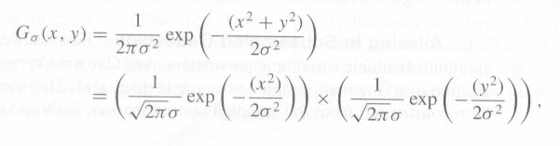
Why Gaussian for Smoothing
Gaussian is separable

Slide 83
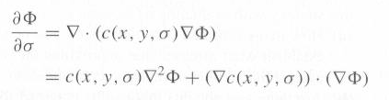
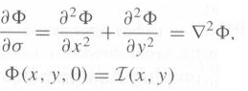
Why Gaussian for Smoothing – cont.
Gaussian is the solution to the diffusion equation
We can extend it to non-linear smoothing

Slide 84
∇²G Filter
Marr and Hildreth approach:
1. Apply Gaussian smoothing using σ's of increasing size:
2. Take the Laplacian of the resulting images:
3. Look for zero crossings.
Second expression can be written as:
Thus, can take Laplacian of the Gaussian and use that as the operator.

Slide 85
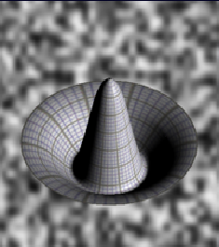
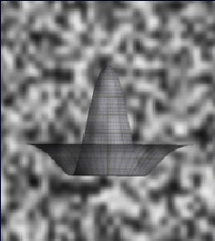
Mexican Hat Filter
Laplacian of the Gaussian
∇²G is a circularly symmetric operator.
Also called the hat or Mexican-hat operator.

Slide 86
σ² Controls Size
σ² = 0.5
σ² = 1.0
σ² = 2.0

Slide 87
Kernels
17 x 17
5x5
Remember the center surround cells in the human system?

Slide 88
Example
13x13 Kernel

Slide 89
Example
13 x 13 LoG Filter
Thesholded Positive
Thesholded Negative
Zero Crossings

Slide 90
Scale Space
17x17 LoG Filter
Thresholded Positive
Thresholded Negative
Zero Crossings

Slide 91
Scale Space
σ² = 2
σ² = 2
σ² =2 2
σ² = 4

Slide 92
Multi-Resolution Scale Space
Observations:
For sufficiently different σ 's, the zero crossings will be unrelated unless there is 'something going on' in the image.
If there are coincident zero crossings in two or more successive zero crossing images, then there is sufficient evidence for an edge in the image.
If the coincident zero crossings disappear as σ becomes larger, then either:
two or more local intensity changes are being averaged together, or
two independent phenomena are operating to produce intensity changes in the same region of the image but at different scales.
Use these ideas to produce a 'first-pass' approach to edge detection using multi-resolution zero crossing data.

Slide 93
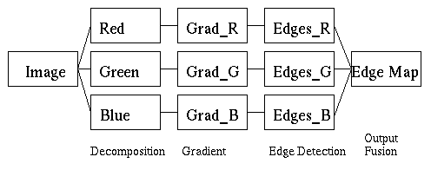
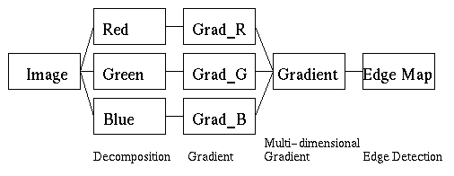
Color Edge Detection
Typical Approaches
Fusion of results on R, G, B separately
Multi-dimensional gradient methods
Vector methods
Color signatures: Stanford (Rubner and Thomasi)

Slide 94
Outline
Convolution: an Introduction
Image Enhancement: Noise Reduction (1)
Convolution: a Revisit
Image Enhancement: Noise Reduction (2)
Edge Detection
An Example: SIFT

Slide 95
SIFT features
Scale-invariant feature transform (SIFT): detects local features in an image [Lowe, 1999].
These local features are called keypoints.
The SIFT features for the keyponts are invariant to scale, illumination, and rotation.
Each keypoint is represented with a 128-dimensional SIFT vector
Notes:
SIFT is used to detect local features in an image. They are called keypoints in the image.
In step 2, , for a given keypoint, warp the region around it to canonical orientation and scale and resize the region. So images with different rotations are transformed to the same orientation for the same keypoint.
Why is SIFT invariant to scale?
This means that it finds the scale of the image which the feature will produce the highest response. Then, the descriptor is calculated in that scale. So when you use a smaller/larger version, it should still find the same scale for the feature.
Why is SIFT invariant to illumination/brightness?
A brightness change in which a constant is added to each image pixel will not affect the gradient values, as they are computed from pixel differences. Therefore, the descriptor is invariant to affine changes in illumination.
To get rotation invariance, Lowe proposed to find the main orientation of the descriptor, and assign that angle to the keypoint. Using this information, it becomes easy to compare two keypoints.

Slide 96
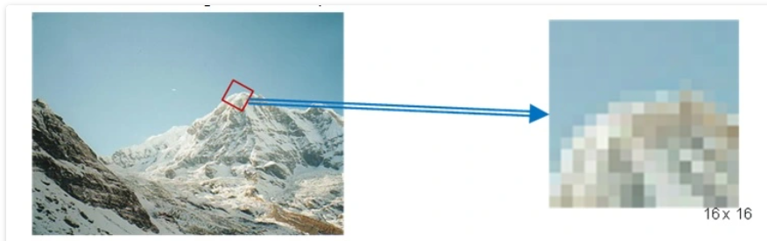
SIFT features
First, detect keypoints using the SIFT detector, which also detects scale and orientation of the keypoint.
Next, for a given keypoint, warp the region around it to canonical orientation and scale and resize the region to 16X16 pixels.
https://gilscvblog.com/2013/08/18/a-short-introduction-to-descriptors/

Slide 97
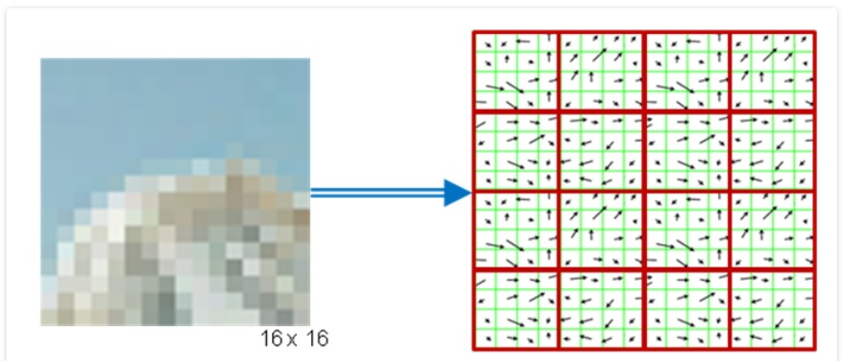
SIFT features
Compute the gradient for each pixel (orientation and magnitude).
Divide the pixels into 16, 4X4 pixels squares.
https://gilscvblog.com/2013/08/18/a-short-introduction-to-descriptors/
Notes:
An image gradient is defined as a directional change in image intensity. Different kernels such as Sobel, Prewitt, etc are derived to use convolution to approximate the gradient. The gradient orientation points in the direction of the largest possible intensity increase. The magnitude is the rate of change in that direction.
X-gradient will find vertical edges and y-gradient will find horizontal edges because edges in an image have abrupt change in the intensity values. Therefore, the largest values will occur across an edge. Edges are perpendicular to the gradient direction(largest). That is why we can use gradients for edge detection.

Slide 98
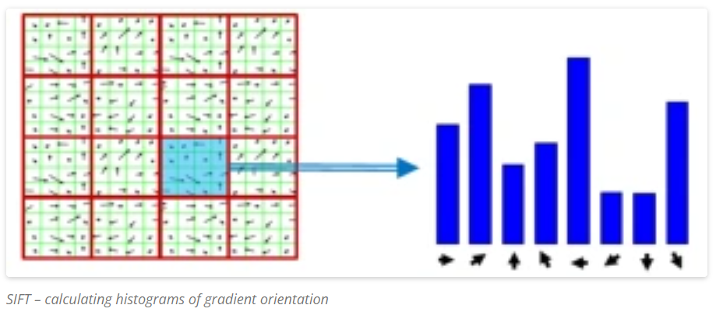
SIFT features
For each square, compute gradient direction histogram over 8 directions
6. Concatenate the histograms to obtain a 128 (16*8) dimensional feature vector:
https://gilscvblog.com/2013/08/18/a-short-introduction-to-descriptors/

Slide 99
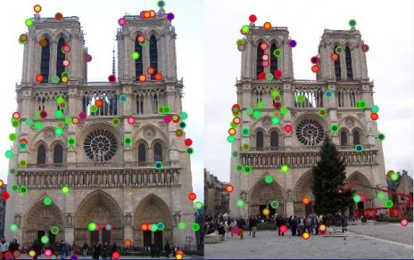
SIFT features:
SIFT features can be used to
align images
rotate, scale, reshape images
characterize and compare images:
bag-of-SIFT-features
Each keypoint has a 128-d SIFT feature vector

Slide 100
Summary
Convolution: an Introduction
Image Enhancement: Noise Reduction (1) - lowpass
Convolution: a Revisit
Image Enhancement: Noise Reduction (2) - median
Edge Detection – first and second order detectors
An Example: SIFT

